Slide 1
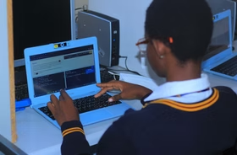
CSEDBOTSWANA Hour of Code 2025
AI and ML and Programming Training
IN PARTNERSHIP WITH THE MINISTRY OF CHILD WELFARE AND BASIC EDUCATION BOTSWANA , LIQUID INTELLIGENT TECHNOLOGIES AND SAGEFOX CONSULTING GROUP

Slide 2
Your training team today
Doug Case
San Jose State University
Lecturer and Former Senior Software Engineer Silicon Valley
USA
Dr Ethel Tshukudu
San Jose State University
University of Botswana
Founder of CSEdBotswana
Tebogo Molebatsi
Senior Teacher-ICT
Botswana

Slide 3
Agenda
Introduction to CSEdBotswana vision
What is Hour of Code and Date
What is AI and ML
Use of AI in the Classroom
Why should Botswana students learn about AL and ML
Introduction to ML and Ai activity
Questions and Answers
Post Survey and Attendance Register
Do you want to Open a Code Club

Slide 4
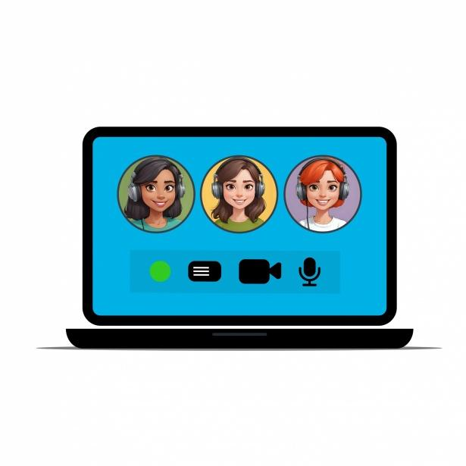
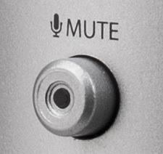
Please mute your microphone unless we ask you to speak
Please turn on your camera if you are comfortable.

Slide 5
Over to you!
Please type into the chat and tell us who you are and which school you are from. Are you joining from a computer or a phone?

Slide 6
01
CSEdBotswana

Slide 7
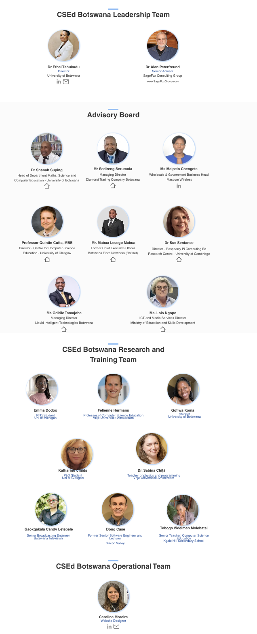
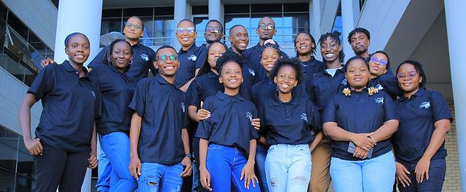
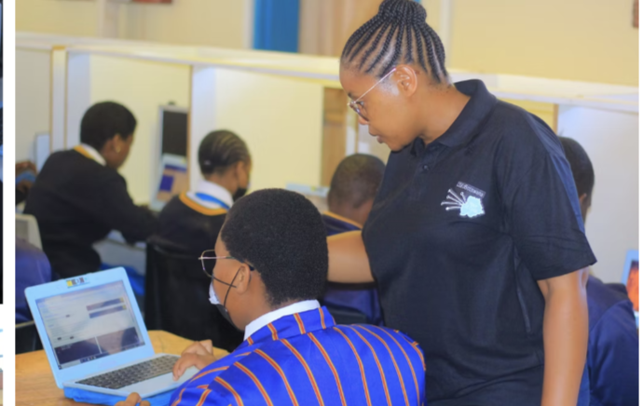
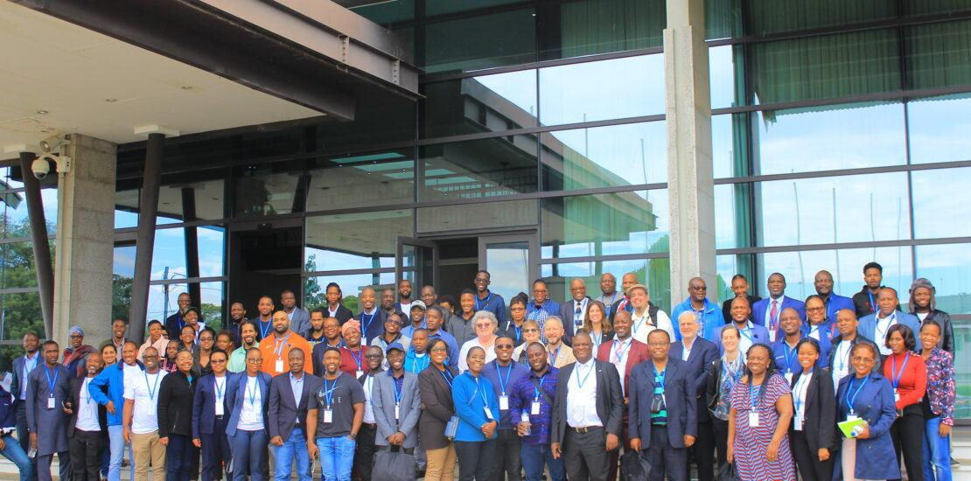
CSEdBotswana aims to increase access to Computer Science education in schools across Botswana and make it a core part of the education system.

Slide 8
CSEdBotswana Efforts in Botswana
First Computer Science Education Summit Hour of Code 2023 Hour of Code 2024 20 Code Clubs Now Hour of Code 2025

Slide 9
02
Hour of Code 2025

Slide 10
Who is this session for?
This session is suitable for all teachers for their own learning. For the Hour of Code event, AI and ML may be more suitable for junior and senior secondary schools or upper-level primary schools.

Slide 11
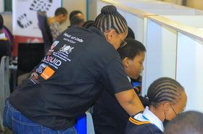
Hour of Code 2025
What Teachers will need to do to coordinate Hour of Code 2025
-Organize and Schedule
-Organize Resources
-Select Students
-Give us a report of how it went
-Share pictures (Do not take faces of students, just their backs coding)
-Make good noise on social media
-Get your participation certificate
Date: 14 April 2025
-Time of Hour of Code:2pm-4:30pm
-Venue: Your own school
-Number of Students: 20+, depending on what your school can manage

Slide 12
03
What is AI and ML

Slide 13
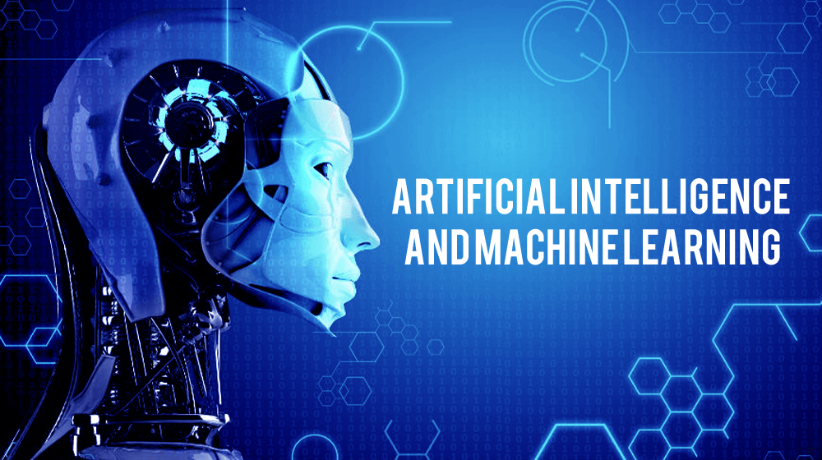
What is AI and ML
Think of AI as a student who has the potential to
learn a variety of tasks.
be taught to solve specific problems, just like a student can be trained to perform specific subjects (like math or reading).
However, unlike a human student, AI doesn't 'think' independently;
it relies on specific instructions and trained data to perform tasks.

Slide 14
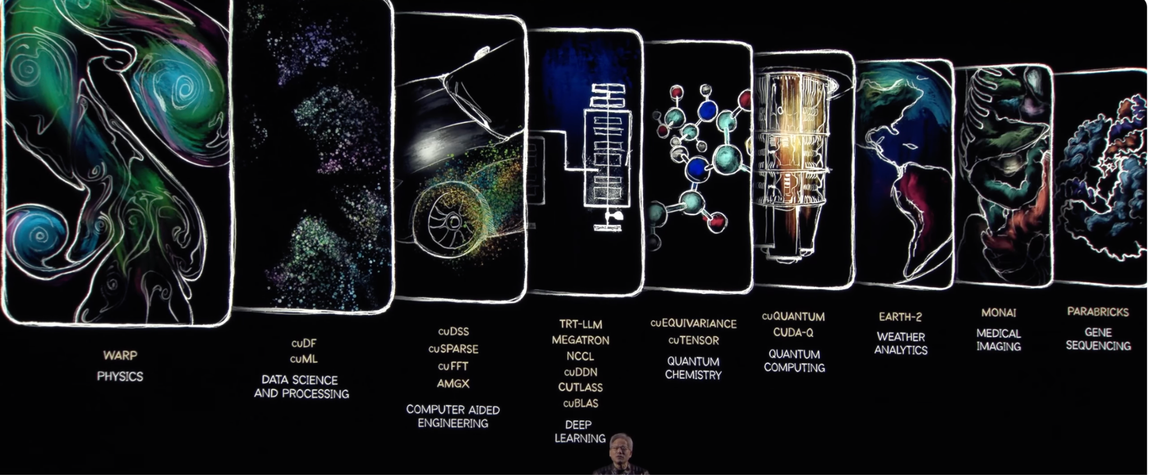
Uses of AI and ML in Real World
https://www.youtube.com/watch?v=_waPvOwL9Z8
Notes:
https://www.youtube.com/watch?v=_waPvOwL9Z8

Slide 15
Uses of AI and ML in Real World
https://nextgeninvent.com/blogs/use-cases-of-generative-ai-in-healthcare/

Slide 16
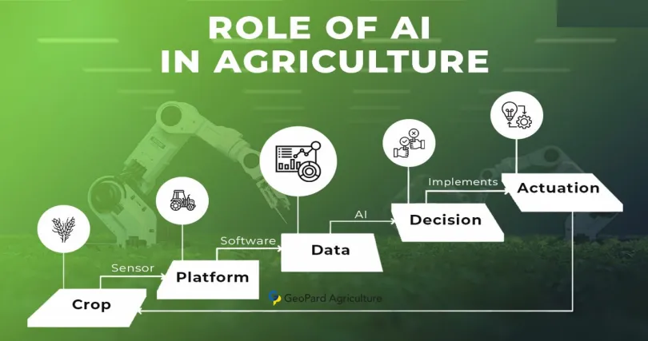
https://geopard.tech/blog/applications-of-artificial-intelligence-for-precision-agriculture/
Notes:
https://geopard.tech/blog/applications-of-artificial-intelligence-for-precision-agriculture/

Slide 17
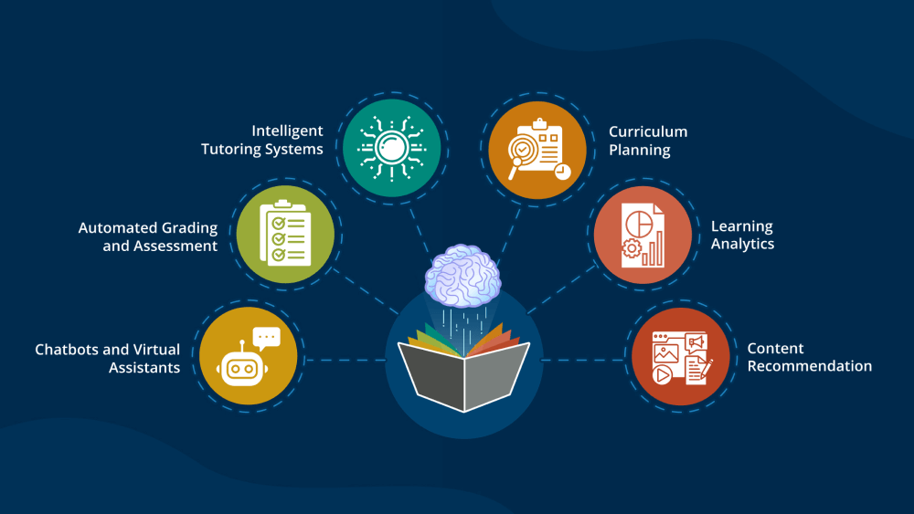
AI IN EDUCATION
https://www.leewayhertz.com/ai-use-cases-in-education/

Slide 18
04
Learning AI and ML

Slide 19
Machine Learning
Machine learning is one way of making AI systems smarter by allowing them to
train on data,
learn patterns
and improve over time without human intervention.
This is what you, as teachers, will be learning today.

Slide 20
Machine Learning Training
MachineLearningforKids is a fun way platform to help learners understand how AI can
"learn" from data (lots of information or examples).
We give the computer many examples, and the computer looks at the data to find patterns.
Then, it uses those patterns to make decisions or predictions on its own.
Go to https://machinelearningforkids.co.uk

Slide 21
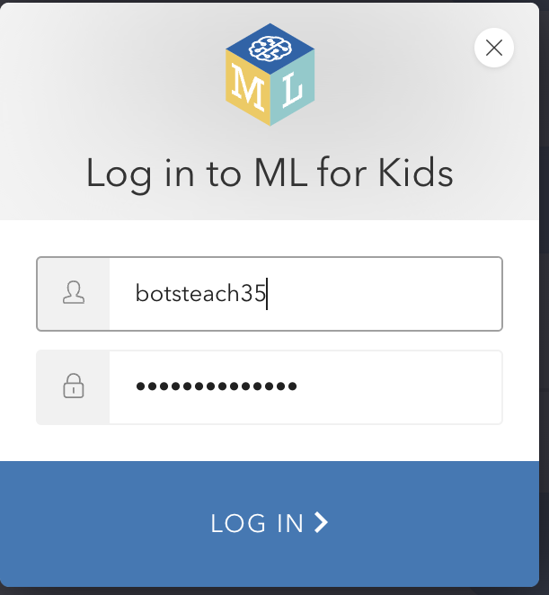
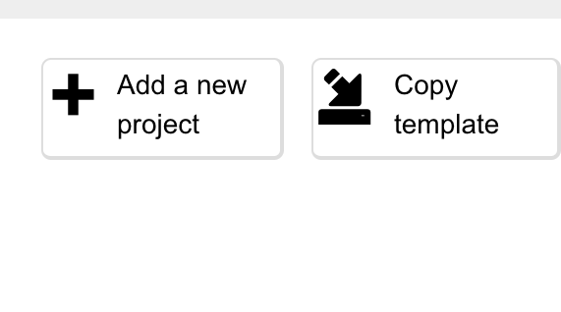
Go to https://machinelearningforkids.co.uk
Login with your Training ID and password

Slide 22
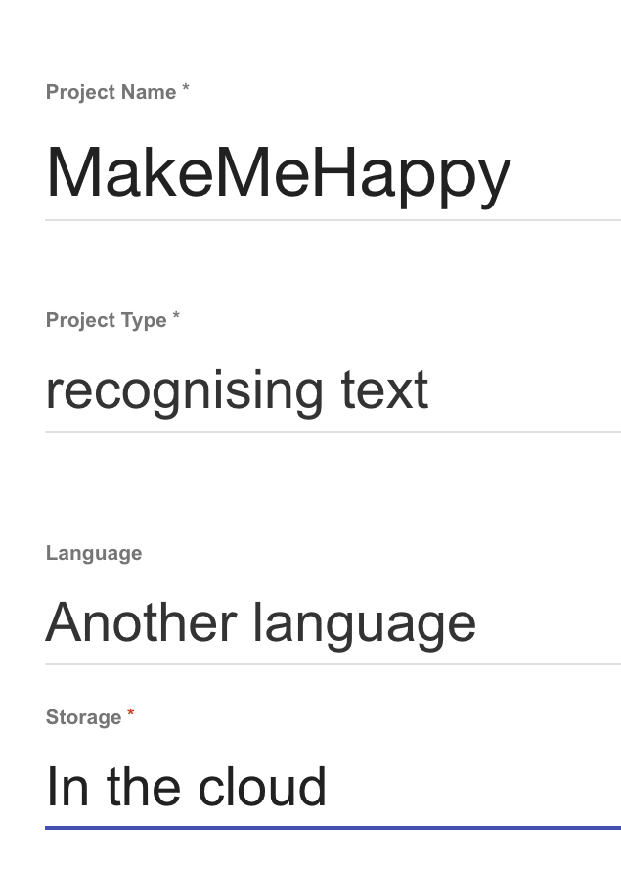
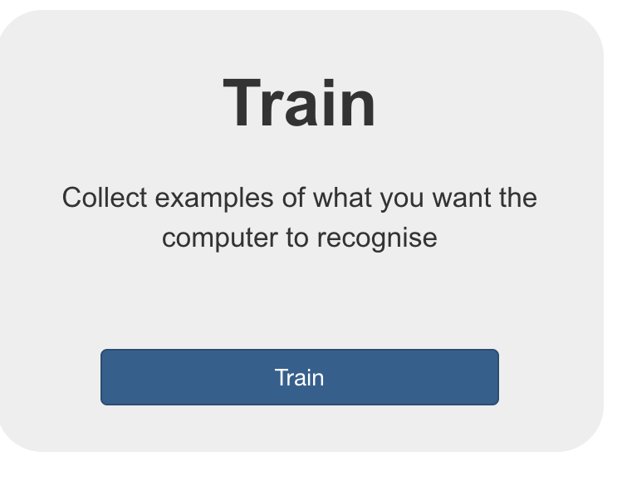
Go to https://machinelearningforkids.co.uk
Login with your Training ID and password

Slide 23
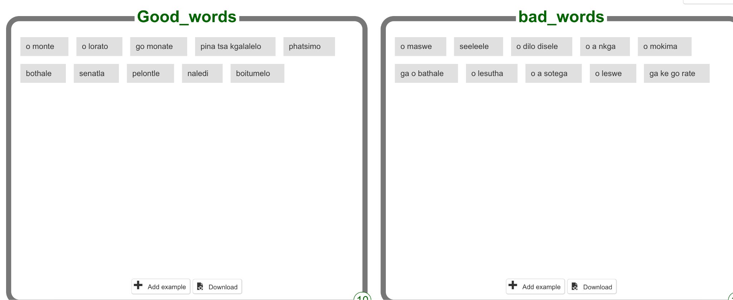
Data Classification
Click Add Label
Good words
Bad Words
Add 10 words to each label
Use Setswana of you like

Slide 24
Data Classification
Supervised Learning
Text Recognition
Data Collection
Data Labelling

Slide 25
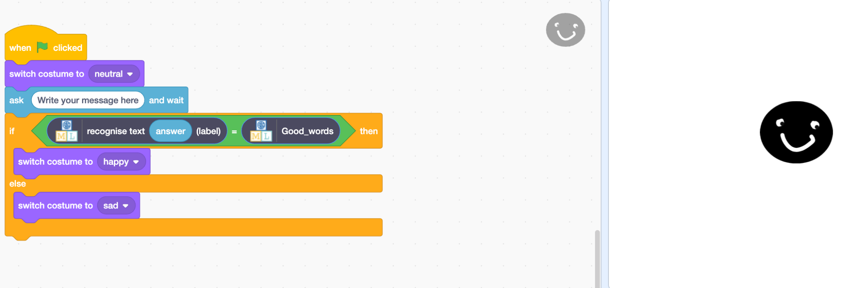
Embedding Machine into Programming project

Slide 26
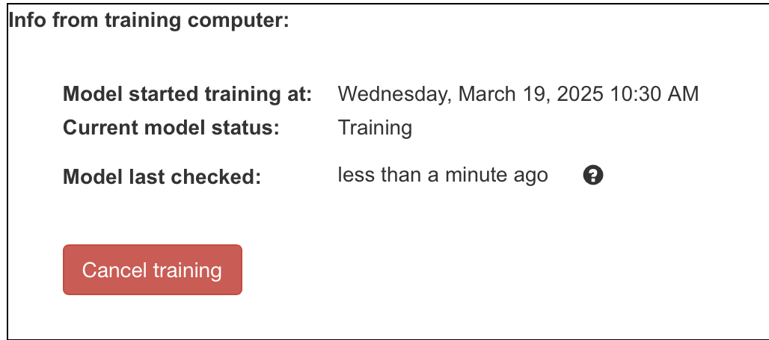
Machine Learning Training
The machine looks at these words and learns the differences between "good" and "bad" words. It finds patterns

Slide 27
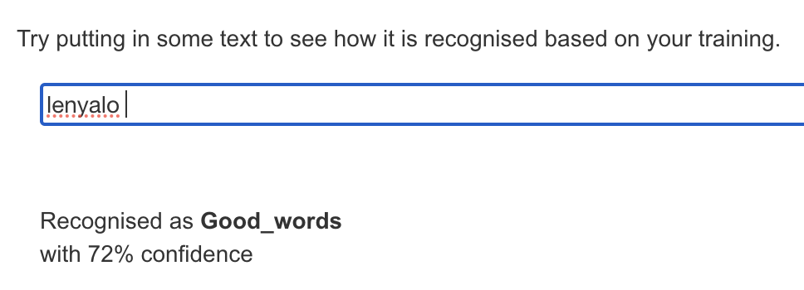
Testing the Machine: Accuracy
We give the computer new words that it hasn’t seen before and ask it to guess whether they are "good" or "bad." Example: If we give the setswana word "lenyalo," the computer should recognize it as "good."

Slide 28
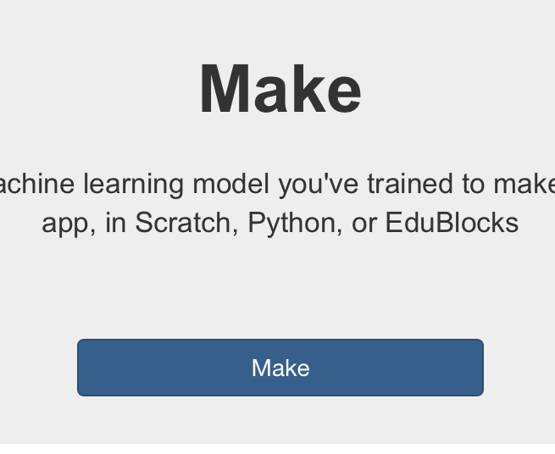
Embedding Machine into Programming project
Integrate the machine learning model into a Scratch project
Scratch is a simple, visual programming language designed for younger learners
You can teach a computer to recognize patterns (like identifying images or making predictions) using machine learning. Once you've trained this model, you can connect it to a Scratch project, allowing students to use AI in their games or interactive stories.

Slide 29
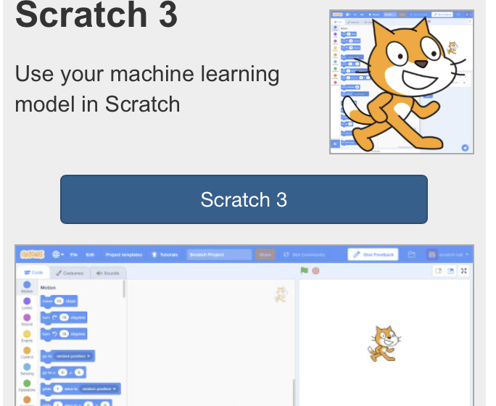
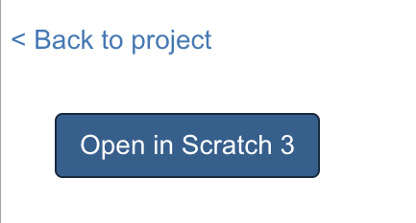
Embedding Machine into Programming project
Integrate the machine learning model into a Scratch project

Slide 30
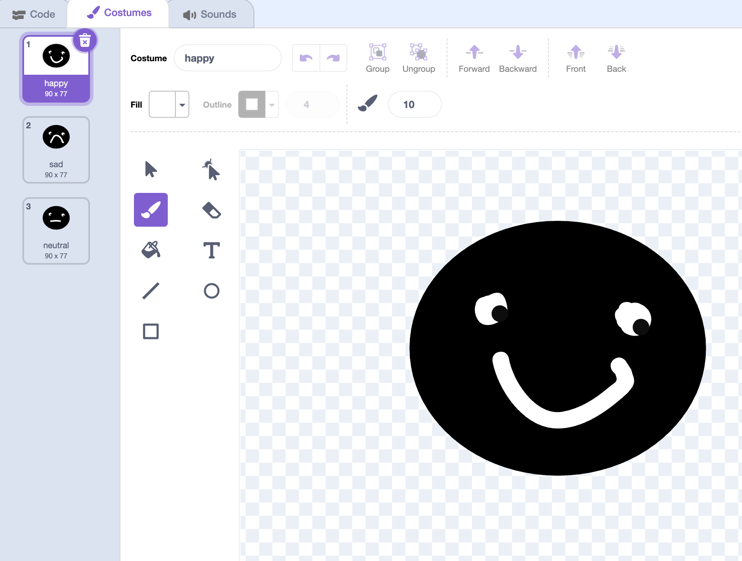
Embedding Machine into Programming project
Create 3 sprites with faces
Happy
Sad
Neutral
You can draw 3 costumes
(sad, happy neutral)

Slide 31
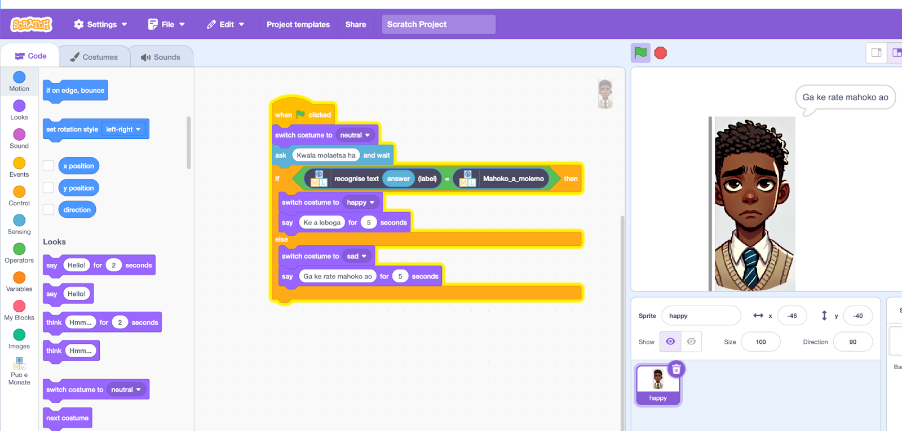
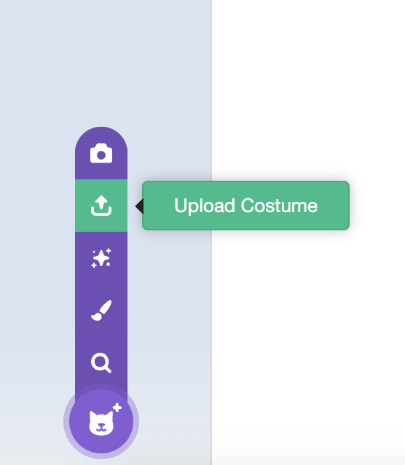
Embedding Machine into Programming project
You can also upload image

Slide 32
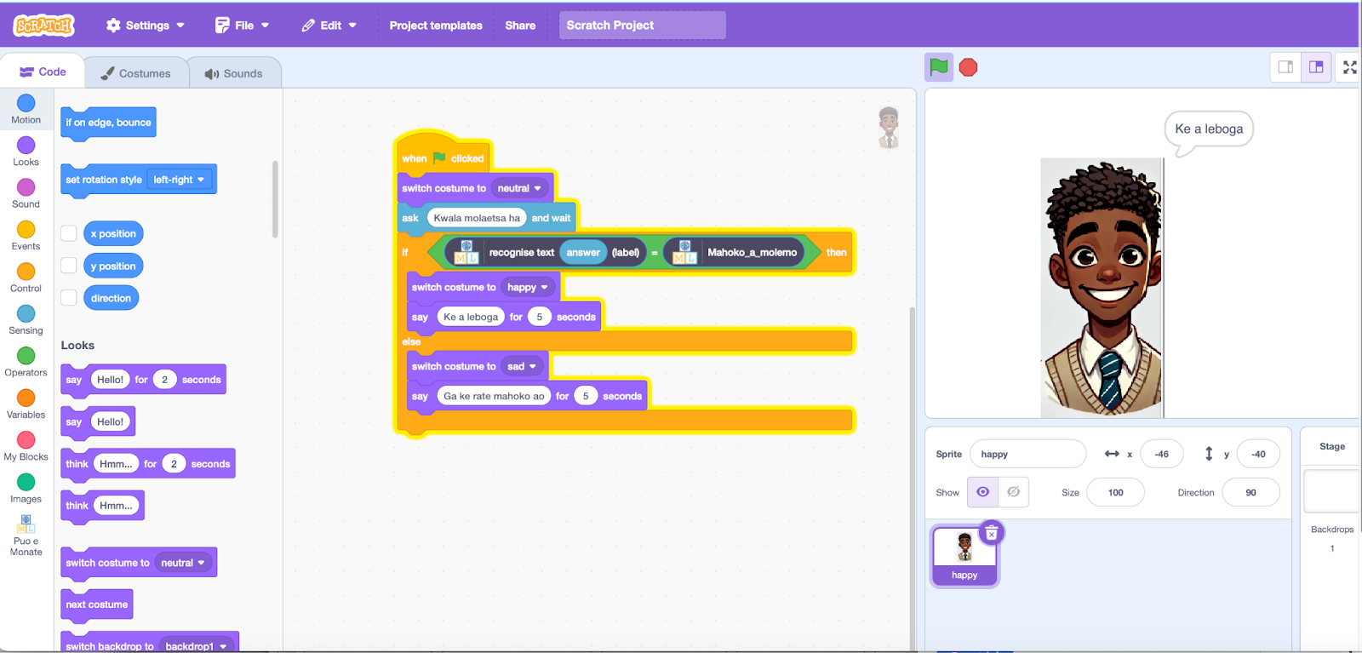
Embedding Machine into Programming project
Integrate the machine learning model into a Scratch project

Slide 33
Understanding AI and Ethics
Bias: AI can be unfair if trained on biased data.
Error: AI can make mistakes
Privacy: AI uses personal data, raising privacy concerns.
Accountability: Clear responsibility is needed when AI makes mistakes.
Transparency: AI decisions should be understandable.
Impact: AI could affect jobs and society, requiring careful planning.

Slide 34
05
Questions and Answers

Slide 35
06
Additional Materials
The Raspberry Pi / Google DeepMind one is called: https://experience-ai.org/en/
The CSTA / US one is called: https://www.teachai.org/

Slide 36
07
Post Survey

Slide 37
08
Code Club Registrations

