Slide 1
CSEdBotswana Hour of Code 2025
Unplugged Computing
Thursday 27th March
In partnership with the Ministry of Child Welfare and Basic Education Botswana, Liquid Intelligent Technologies and SageFox Consulting Group

Slide 2
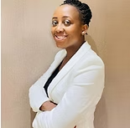
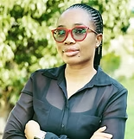
Your training team today
Katharine Childs
University of Glasgow
United Kingdom
(Former primary computing teacher)
Dr Ethel Tshukudu
University of San Jose
Founder of CSEd Botswana
Gaokgakala Alogeng
Senior Broadcasting Engineer
Botswana Television

Slide 3
Agenda
Introduction to CSEdBotswana vision
What is Hour of Code and Date
What is unplugged computing?
What are the benefits of unplugged computing?
Activity 1 - Draw a character
Activity 2 - Guess the word/sentence
Questions and Answers
Do you want to Open a Code Club

Slide 4
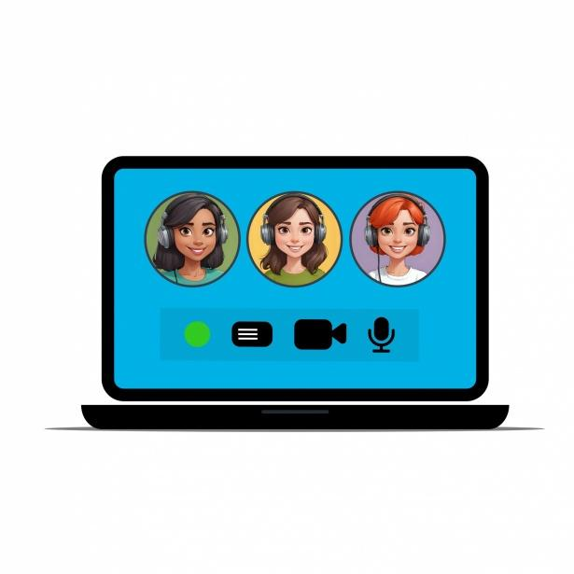
Please mute your microphone unless we ask you to speak
Please turn on your camera if you are comfortable.

Slide 5
Over to you!
Please type into the chat and tell us who you are and which school you are from. Are you joining from a computer or a phone?

Slide 6
Introduction

Slide 7
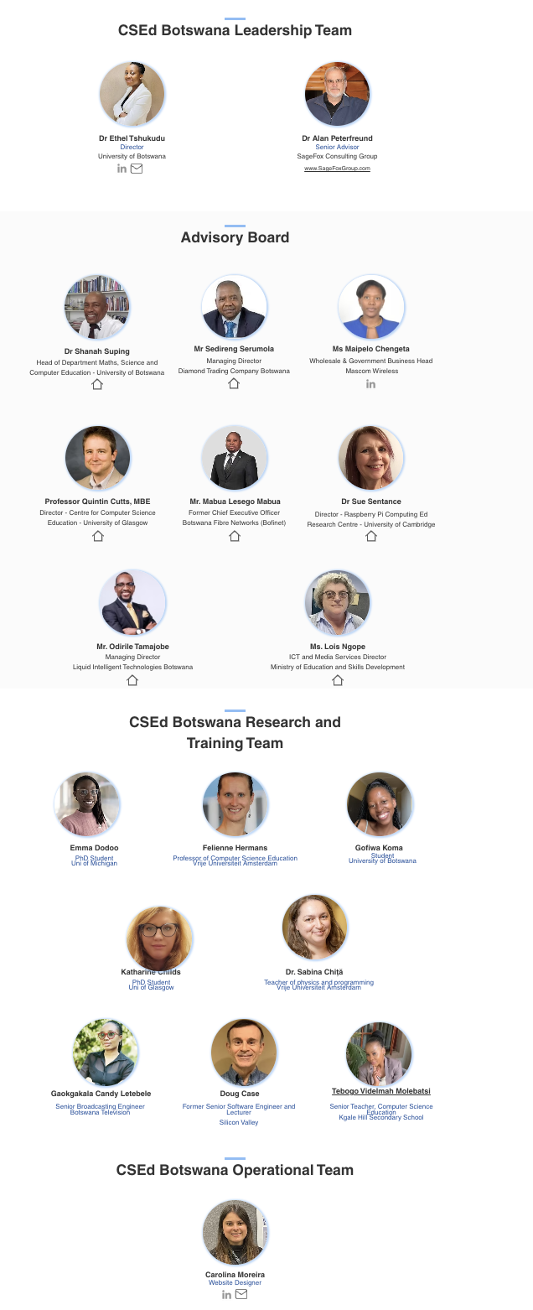
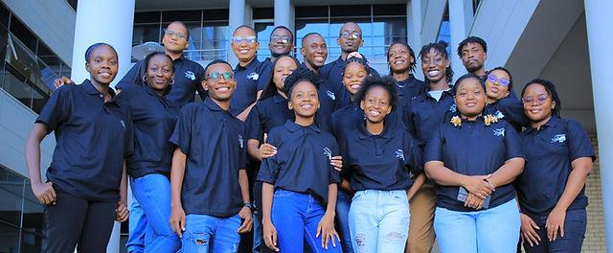
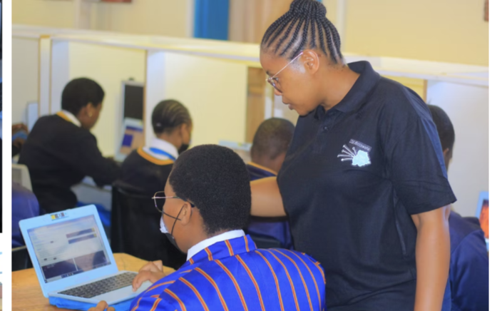
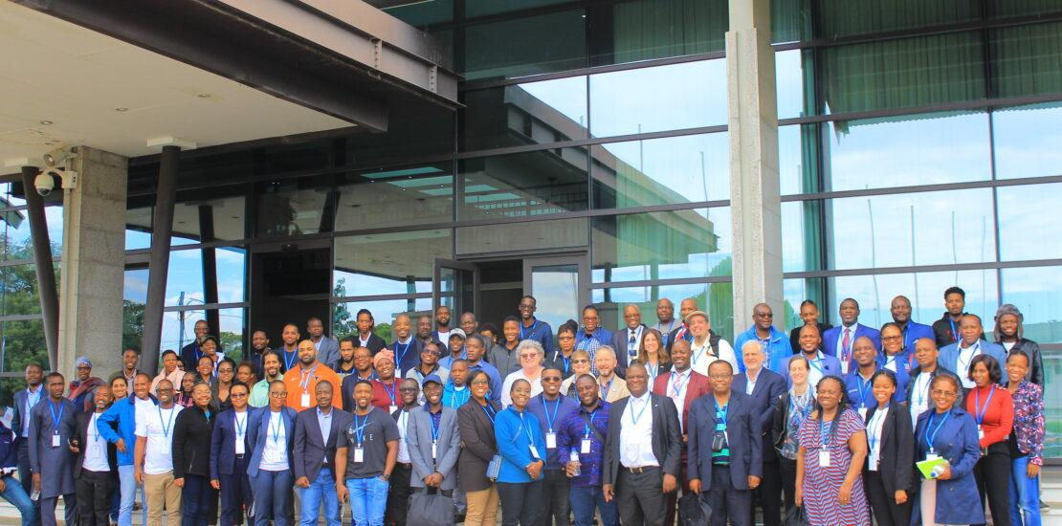
CSEdBotswana aims to increase access to Computer Science education in schools across Botswana and make it a core part of the education system.

Slide 8
CSEdBotswana Efforts in Botswana
First Computer Science Education Summit Hour of Code 2023 Hour of Code 2024 20 Code Clubs Now Hour of Code 2025
Find out more on our website at: www.csedbotswana.org

Slide 9
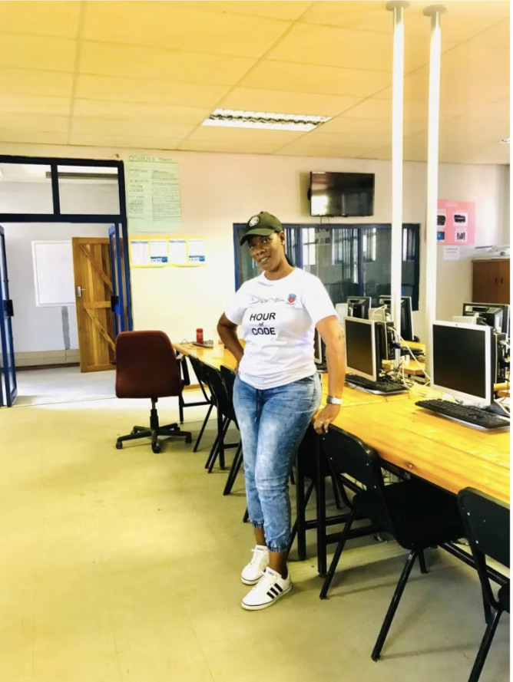
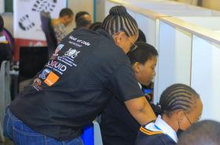
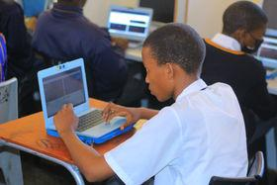
Hour of Code 2025
What Teachers will need to do to coordinate Hour of Code 2025
Organize and Schedule
Organize Resources
Select Students
Give us a report of how it went
Share pictures (Do not take faces of students, just their backs coding)
Make good noise on social media
Get your participation certificate
Date: 14 April 2025
-Time of Hour of Code:2pm-4:30pm
-Venue: Your own school
-Number of Students: 20+, depending on what your school can manage
www.csedbotswana.org

Slide 10
Unplugged computing

Slide 11
What is unplugged computing?
Unplugged activities teach computer science without using any gadgets or computers
The goal is to learn computer science in an accessible, inclusive way

Slide 12
Benefits of Unplugged Activities
Students can link computing ideas to their everyday lives and experiences
Students can use their literacy and mathematics skills. It is an opportunity to develop these skills in a fun way by solving problems
Unplugged activities are creative and collaborative - all you need is a pen or pencil and some paper

Slide 13
Activity 1
Draw a character

Slide 14
An example of an unplugged activity
Please get a pen or pencil and a blank piece of paper
Computers need clear instructions written as code - this is what learning to program is all about. Programming can be difficult, and planning helps!
An algorithm is a step-by-step set of precise instructions that is written in everyday language to help plan computer code.

Slide 15
Draw a picture
I am thinking of a picture. I am going to ask you all to draw a it. Listen carefully to each step and draw what I am thinking of.
Step 1
Step 2
Step 3
Step 4
Step 5
Notes:
Draw a circle for the body
Add two eyes
Add a crown
Add wings
Add legs
Can also type these in the chat

Slide 16
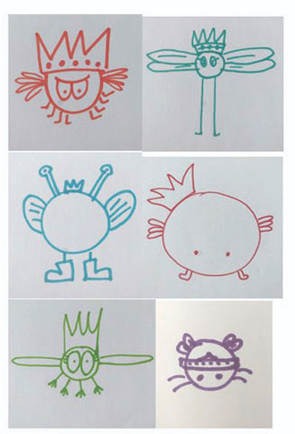
The results
Please turn on your camera and show your picture up to the camera so we can all see.
Do all your pictures look the same?

Slide 17
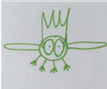
How can we improve the instructions?
This is my character! How can we improve these instructions?
Draw a circle for the body
Add two big eyes on the body. There is no head.
Draw a crown on top of the circle
Draw two oval wings, one on each side of the body
Draw four legs below the body
Please type your answers into the chat. Use the format step number and your improvement, e.g. Step 1 - Draw a large circle for the body

Slide 18
Running this activity in your classroom
Have your students work in pairs
Explain that their are going to learn about writing an algorithm
Explain that an algorithm is a precise, step-by-step sequence of instructions. Computers need precise instructions in code. In this activity we will write the instructions in English or Setswana.*
Get the children to carry out the activity in pairs and then to improve their algorithm.
*Please use the same language that you usually do for teaching

Slide 19
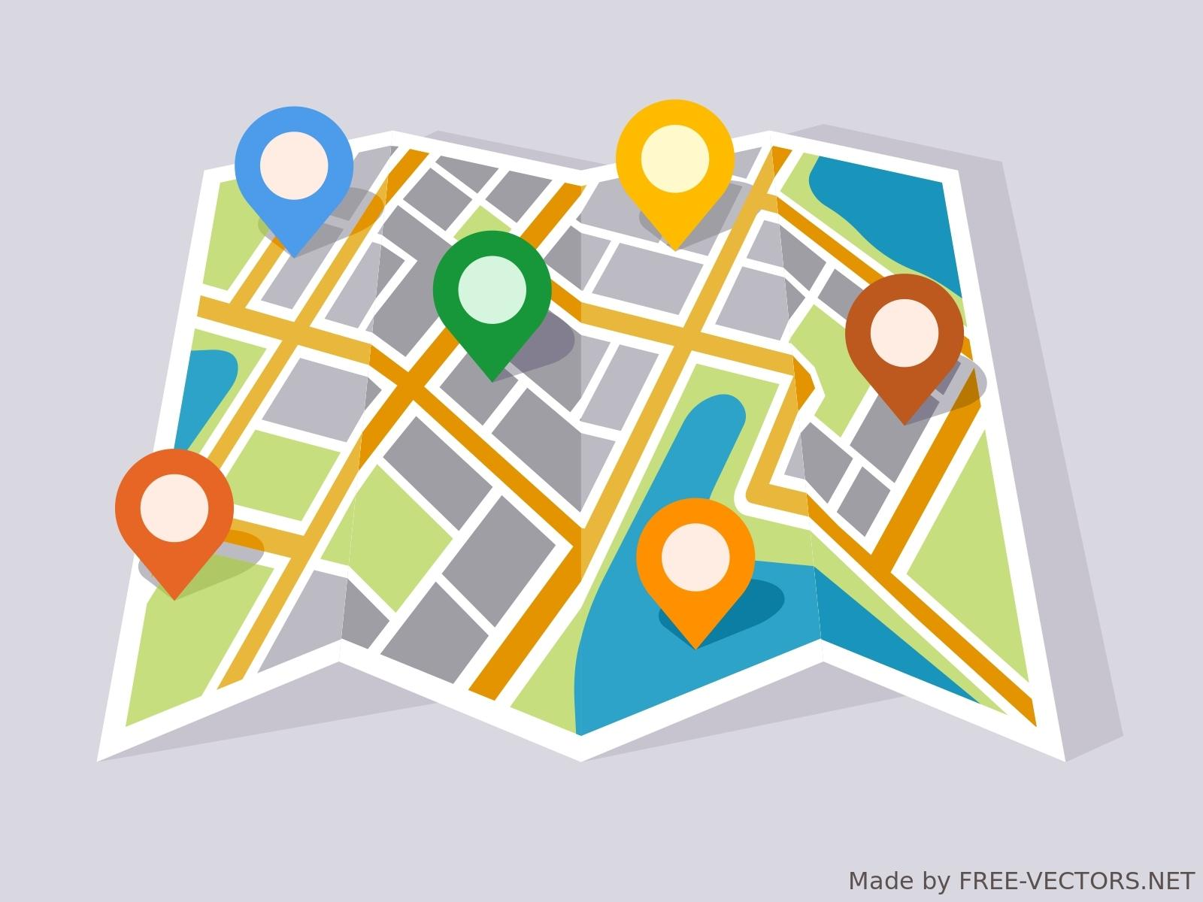
Other examples of algorithms
If you have time, you can discuss with your students some other examples of instructions in everyday life that have to be precise. You could even ask them to write down their favourite recipe, directions from home to school or instructions for brushing their teeth.
Can you think of any other instructions that have to be precise? Please type your answers in the chat
Notes:
What happens if the recipe is not precise? Food tastes bad
What happens if directions are not precise? You get lost
What happens if tooth brushing is not precise? A mess!
Maybe the teachers have routines in their classroom at the start or end of the day - these could be algorithms

Slide 20
Recap
In this activity, we have learned:
An algorithm is a precise, step-by-step set of instructions
Programmers turn algorithms into code that computers can understand
Algorithms can be found in everyday experiences
If an algorithm is not precise enough, we can improve it
Notes:
LInk to full resource: https://www.barefootcomputing.org/resources/crazy-character-algorithms

Slide 21
Activity 2
Guess the word or sentence

Slide 22
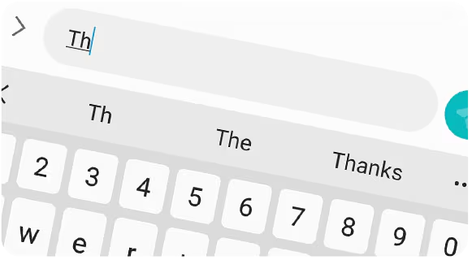
Guess the word
For this activity you will need a pen or pencil and paper.
We all have predictive text on our mobile phones.
Sometimes it saves us time by guessing what we want to say.
Sometimes it is annoying because it predicts the wrong thing!
In this activity we are going to explore how predictive text works.

Slide 23
A demonstration of the activity
I am thinking of a word. It is an English word.
It has five letters
_ _ _ _ _
Please type in the chat what you think the first letter is. ONLY the first letter.
Notes:
Keep going until we reach the first letter.
Then do the second letter, third, fourth and fifth.

Slide 24
Let’s have another go
Gao is thinking of a word in Setswana
Please type in the chat what you think the first letter is. ONLY the first letter.
Notes:
In Setswana?

Slide 25
Guess the word / sentence
Is it easier to guess a letter at the beginning of the word or at the end of a word?
The letters that were hardest to guess had the most information in them, like the H in HELLO.
The letters that were easiest to guess had the least information in them, like the O in HELLO
Computer systems turn data into information to make predictions, like predictive text.

Slide 26
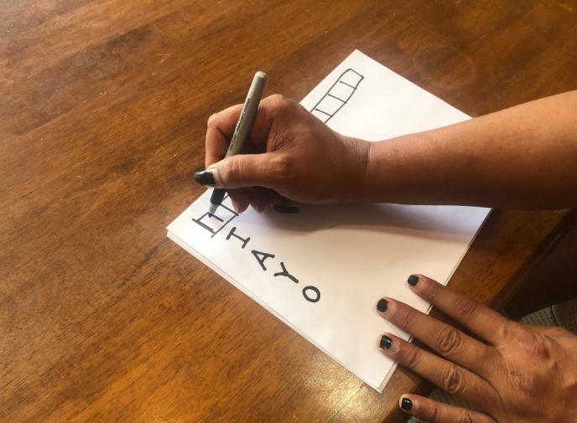
Running this activity in your classroom
Have your students work in pairs or small groups of three
Explain that their are going to learn about how computers can predict what letter or word comes next on a mobile phone.
Students take it in turns to write a word or a sentence in English or Setswana* and then have the other student(s) guess it letter by letter.
*Please use the same language that you usually do for teaching

Slide 27
Ways to extend this activity
Ask students to think of words that might be hard to guess because they have unusual letter combinations (e.g. queue)
What do students think are most common letter combinations? English examples: ed, th,
Ask students to guess completely random mixtures of letters like “AIQENFPZQURVSXOS”, How many guesses do they need for each letter?
What happens if students are allowed to add in numbers (0-9) and special characters (!”£$%^&*(), like in a computer password. How easy is that to guess?

Slide 28
Recap
In this activity we have learned:
Words are made up of letters and these letters contain information that computers can use to predict what letter comes next
Some letters contain more information than others
Random letters in words are harder to guess, and these are important in computer passwords

Slide 29
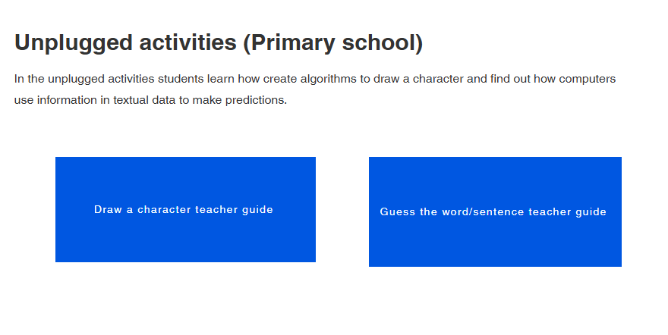
Where can I get help to run these activities with my students?
www.csedbotswana.org/training

Slide 30
Questions and Answers

Slide 31
Post Survey

Slide 32
Code Club registrations

